Slide 1
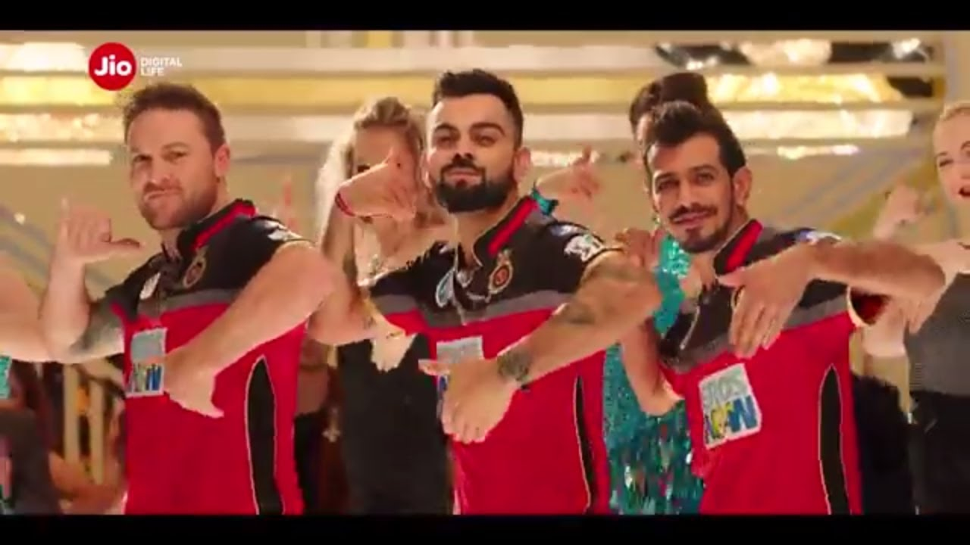
Reliance Jio – Case Study - SHRM
Welcome to all. This is Group 1 – Sagana, Aparna, Suresh, Saravanan & Anju

Slide 2

Disruptive marketing means turning all the marketing rules upside down, shaking things up and changing the perception not just about your company but about the industry as a whole.
As per the theory of disruption, Jio's debut in the Indian telecom space in 2016 was a disruptive innovation as it brought non-customers of data to the market through ultra-low-cost smartphones and data tariffs.

Slide 3
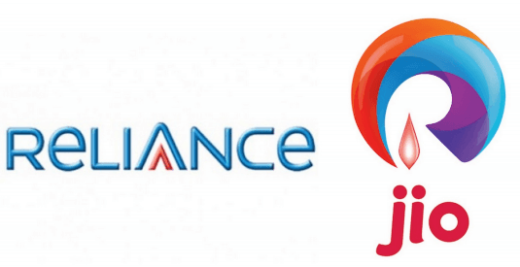
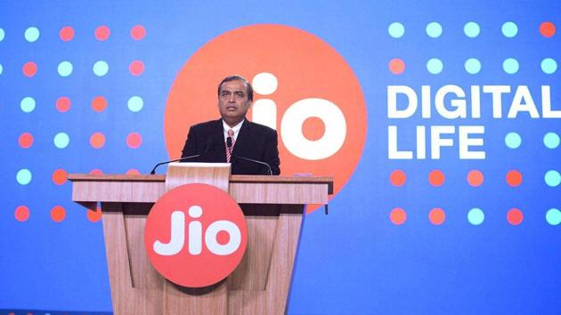
Question No. 1
How has the business Environment altered for Telcos after the launch of Reliance Jio?
With a bold tariff plan, low-cost mobile phones, and free voice calls for a lifetime, Reliance Jio Infocomm Ltd kicks off a new phase of turbulence in the world’s fastest growing telecom market.
The current market leader Bharti Airtel’s stock dropped by 9 per cent . Idea Cellular Ltd, another important player, lost 7 per cent. Jio’s entry could also mean the end of the road for marginal players like Aircel, R-Com, Tata DoCoMo, and Telenor
For consumers:
Airtel and Vodafone also unleash their own competitive tariff plans. Jio will price mobile phone data as low as Rs.50 per gigabyte (GB). Two days later, Bharti Airtel slashed 4G and 3G mobile Internet charges by up to 80 per cent to as low as 51 per GB in anticipation of the Jio launch.
At the Jio launch, Ambani had said that Reliance Industries had deployed the largest 100 per cent voice over long-term evolution (VoLTE) network, which provides crystal clear voice and video quality, instant call connectivity, the least call drops, and a unique ability to use data and voice simultaneously
Founder – Mukesh Ambani
CEO – Atul Kansal
The company is collaborating with nearly all smartphone makers to bundle three months of free data and voice with handsets.

Slide 4

Question No. 2
Can the launch of Jio be seen as a sustainable business model given the Indian conditions? Comment?
A whopping 80 per cent of Jio’s calls have been failing, according to a statement issued by the company within 15 days of its launch.
Poor data connections has been reported in few of the areas due to tower issues.
Too many freebies which the company was not able to afford in the long run.
Since the 4G connection was new to the market and the customers had 3G smart phone, which lead to lower efficiency.

Slide 5
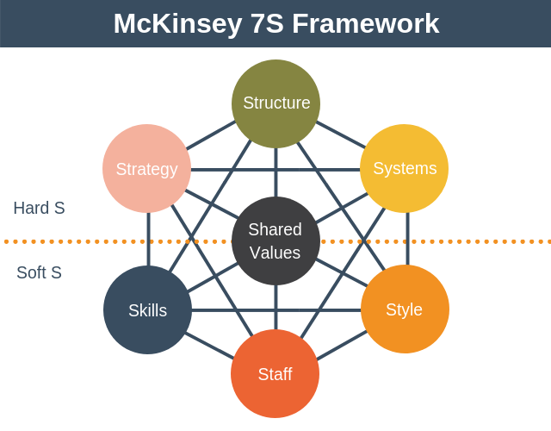
Question No. 3
Reliance Jio is being seen as a game changer in the Indian market with disruptive competitive strategies. What kind of HR approach to strategy do you think this kind of an organization would need?
Hard Elements:
Structure – Flat organization (allows quicker decision-making processes)
Strategy – Cost focus
System - HR system and Analyzer
Soft Elements:
Skills - Innovation and collaboration
Shared Values – Creativity, Trust, Quality
Style – Participative leadership, Collaboration
Staff - Employee engagement, competence & align with business goals
The McKinsey 7S Framework is a management model developed by business consultants Robert H. Waterman, Jr. and Tom Peters in the 1980s

Slide 6
Key HR Approach
Keeping in mind how effectiveness can be achieved in an organization through the interactions of seven key elements – Structure, Strategy, Skill, System, Shared Values, Style, and Staff. We propose the below as the strategy in HR point of view.
Hard Elements:
Structure – For an organization which is more directly influenced by consumer requires to be flat organization . This eases the communication, decision making and implementation of strategies much more easier.
Strategy – In order to build a competitive advantage over the competitors , the organization needs to assess the existing market conditions and come up with cost and customer focused initiatives to win and sustain in the market for a long term.
System - As mentioned in our previous slide the company can invest more on HR systems for seamless and timely communication, processing of HR tasks etc.,. A strong internal HR system can sustain the company in a long run.
Soft Elements:
Skills - The main essence during recruitment and people development needs to be based on innovation, collaboration and competence development. As when the employees are ready for any market challenge it results in the true success of the organization.
Shared Values – These are the core values of the organization and reflect its general work ethic. They were called "superordinate goals“. The keys values would be creativity, trust and quality which needs to resonate in every employee which would translate in to customer success.
Style – The leadership styles needs to be essentially transformational and participative which will encourage all of the above key factors to sustain the organization both internally and externally. Happy Employees Happy Customers !!!
Staff - The employees and their capacities needs to be at par with the market conditions.. Agility, technical and social competence, needs to be engaged to align with the business goals. These characteristics in the employees will translate in to huge success of the business as well as sustenance of the business.

Slide 7

Thank you !! from Group 1

